Slide 1


HOME CREDIT SCORECARD MODEL
Using Logistic Regression & Decision Tree

Slide 2
CASE UNDERSTANDING
Home Credit is currently using various statistical methods and Machine Learning to make credit score predictions. Now, we ask you to unlock the full potential of our data. By doing so, we can ensure that customers who are able to repay are not turned down when applying for a loan, and that loans can be provided with a principal, maturity, and repayment calendar that will motivate customers to succeed. Evaluation will be carried out by checking how deep your understanding of the analysis you are working on is.
GOALS
OBJECTIVE
Predict the credit scores of customers who make loans using machine learning models and provide insights and recommendations so that customers who are able to pay off loans are not rejected when applying for loans.
Predict customer credit scores and minimize the potential for default on loans submitted by customers.
METRICS
Use Recall Metrics and F1-Score to capture more customers with potential credit problems.

Slide 3

FLOW ANALYSIS
EDA
Modelling
data visualization and discovering insights about the business.
Using Logistic Regression & Decision Tree for train and test data.
Data Cleaning
Data Preparation
Drop unnecessary features, Handling missing value, Drop duplication & outliers
Normalize data, Encoding data, Future selection, Solve imbalance data using SMOTE.

Slide 4
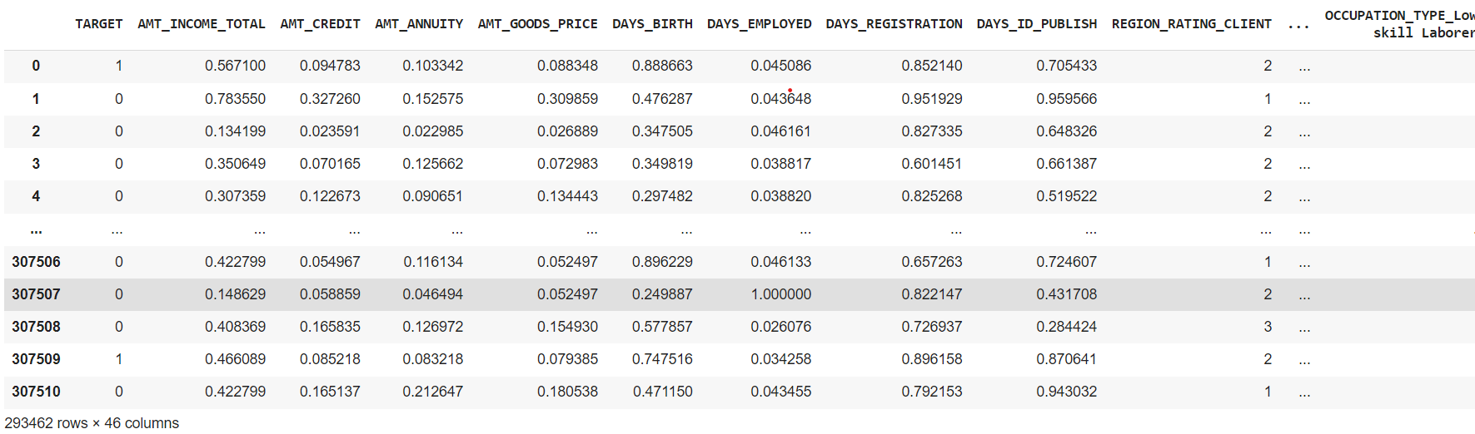
DATA VIEW AFTER CLEANING
Removing some features that are not used or have no effect on the model in general. That leaves 46 columns and 293462 rows.
*Previously there were 122 columns and 307511 rows.

Slide 5

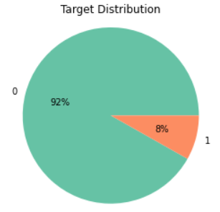
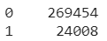
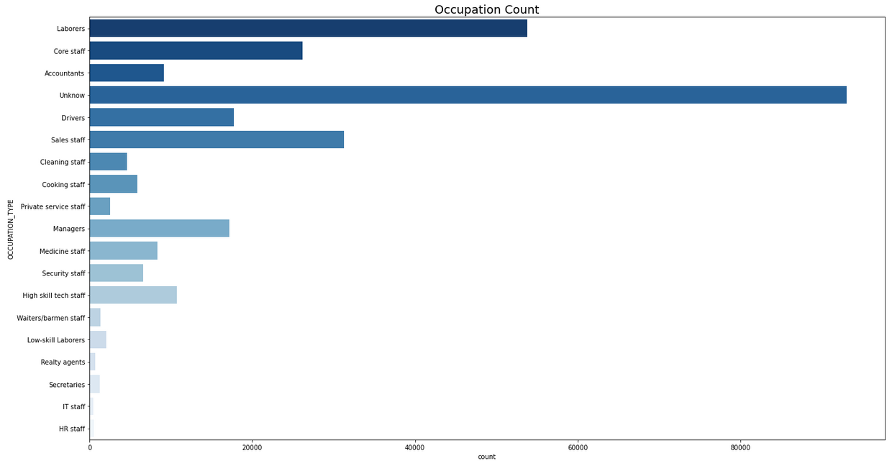
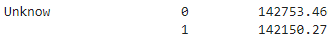
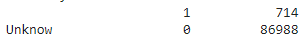
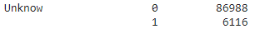
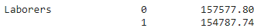
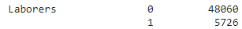
EXPLORATORY DATA ANALYSIS
The target distribution based on the data provided looks unbalanced between the values 1 and 0 so it needs to be more careful when doing modeling.
Income Average
Target Counts
The type of work is unknown and Laborers have a high number of credit applications but the possibility of bad credit is also high, so it is necessary to be careful in handling credit requests from these 2 categories.

Slide 6
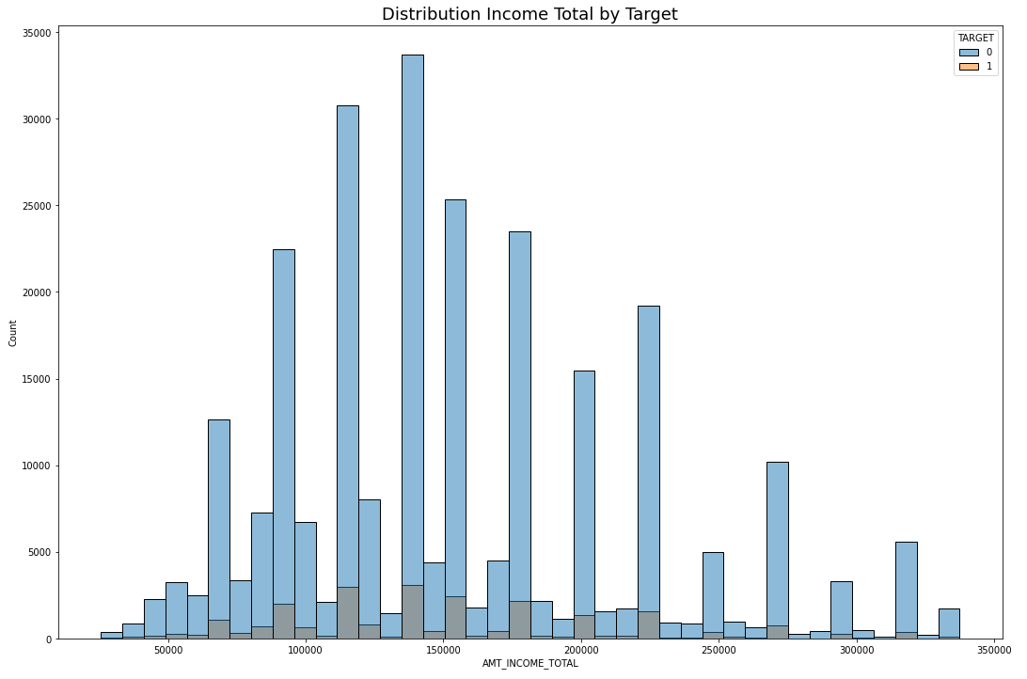
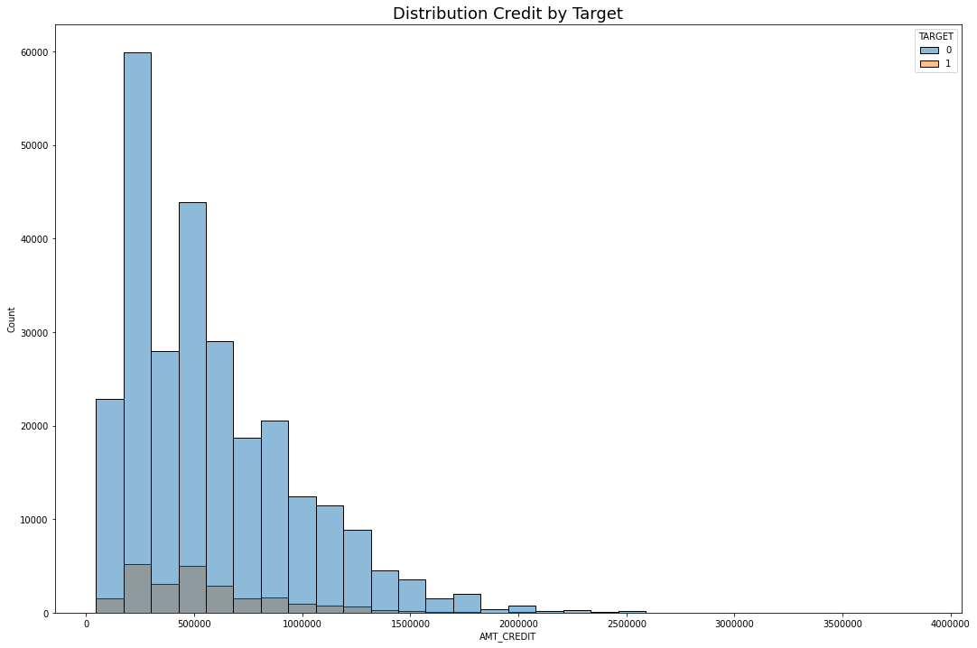
EXPLORATORY DATA ANALYSIS
The higher the customer's total income, the smaller the percentage of loans and the higher the number of loans submitted, the smaller the percentage of bad loans, so a campaign is needed to attract customers with high income.

Slide 7

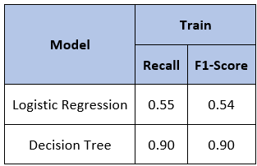
MODELLING
Preprocessing
Normalize data using MinMaxScaller()
Encoding feature ['NAME_CONTRACT_TYPE', 'NAME_INCOME_TYPE','OCCUPATION_TYPE']
Feature selection using PPScore & Feature Importance Random Forest
selected features
'DAYS_EMPLOYED', 'AMT_CREDIT', 'AMT_GOODS_PRICE', 'AMT_ANNUITY', 'DAYS_BIRTH', 'DAYS_REGISTRATION', 'DAYS_ID_PUBLISH', 'DAYS_LAST_PHONE_CHANGE', 'AMT_INCOME_TOTAL'

Slide 8
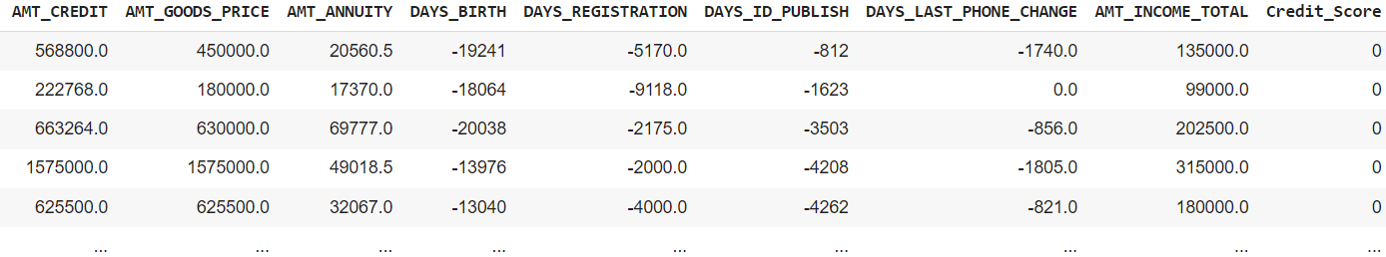
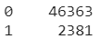
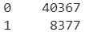
RUN MODEL IN TEST DATA
Logistic Regression
Decision Tree

Slide 9

BUSINESS RECOMENDATION
The Logistic Regression Model can help to predict potential customers with more successful paying rates and the Decision Tree Model can help to predict potential customers with high default rates. The use of the model can be adjusted to the case you want to look for or choose a model according to the results of the meeting with bos.
Furthermore, the recommendation that I can give is to conduct a campaign to attract potential customers with high salaries because according to the analysis, customers with high salaries will have a smaller percentage of defaults. But you need to be careful with some customers with certain jobs because according to the analysis they can default on credit.

Slide 10

Linkedin
https://www.linkedin.com/in/dewa-adji/
THANK YOU
Email
dewaadji12@gmail.com
Github Repository
https://github.com/dewaadji/HCI-Credit-Credit-ScoreCard-Model

